Slide 1

20th Genomic Standards Consortium Meeting, La Jolla May 2018
EcoFAB
Advancing microbiome science
through standardized fabricated ecosystems
Karsten Zengler

Slide 2
20th Genomic Standards Consortium Meeting, La Jolla May 2018
Why do we need model systems?
What could these look like?

Slide 3
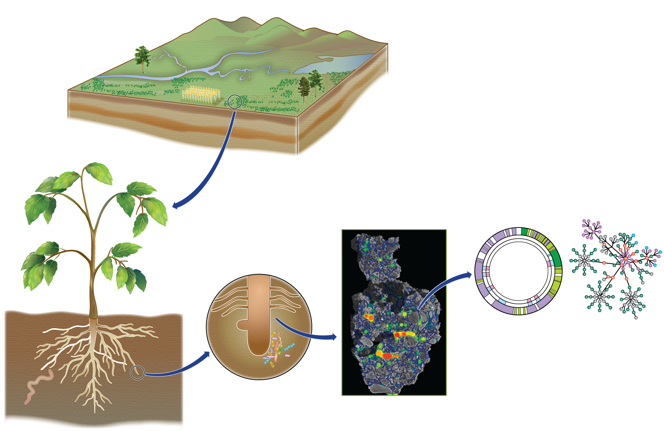
Microbial-Mediated Geochemical Cycles
Microbial
genomes
Microbial
chemicals
Aggregates
(Soil)
Rhizosphere
(Roots)
Carbon
Nitrogen
Phosphorus

Slide 4
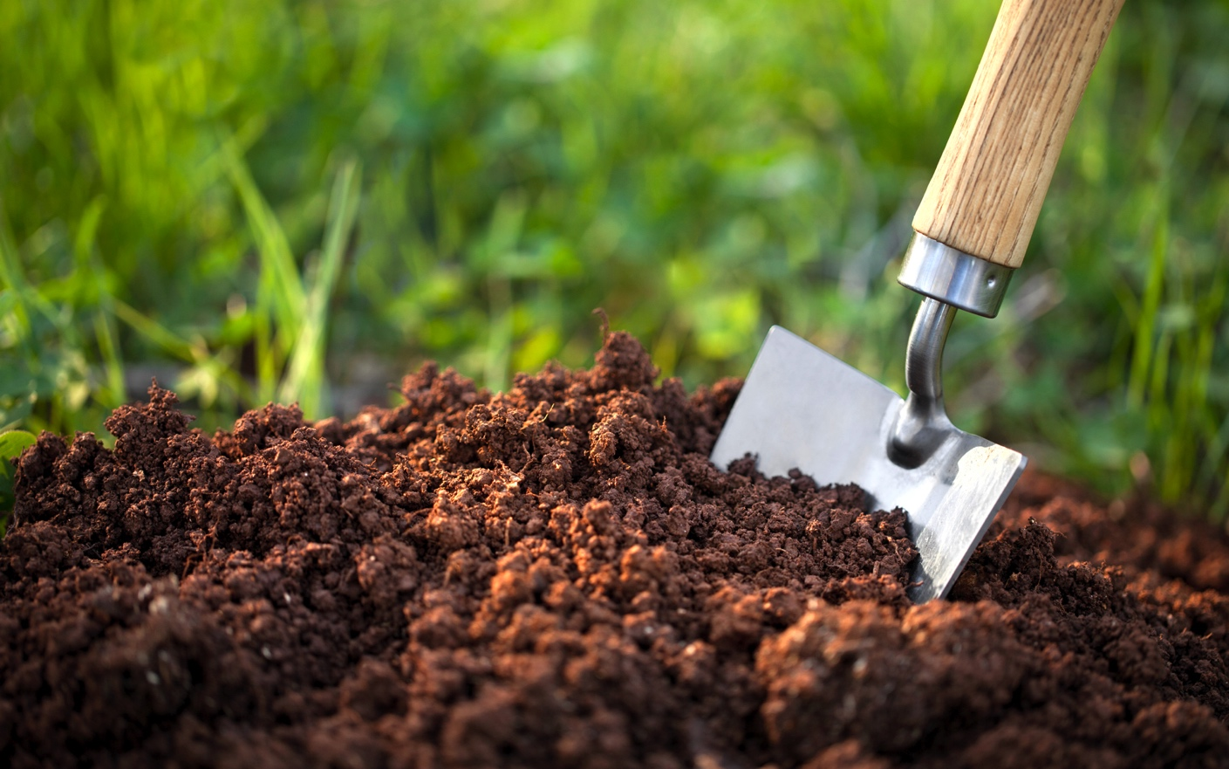
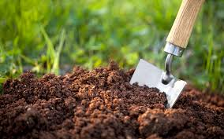


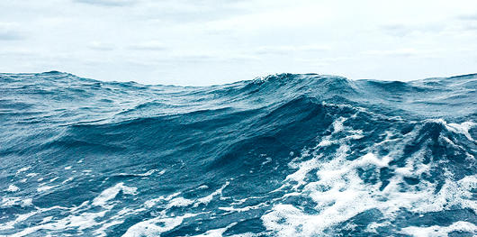
Ecosystem Variability

Slide 5
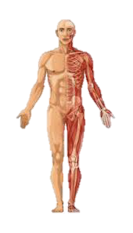
Ecosystem Variability

Slide 6
Most proteins are not functionally characterized
Need for functional data
to complement sequencing

Slide 7
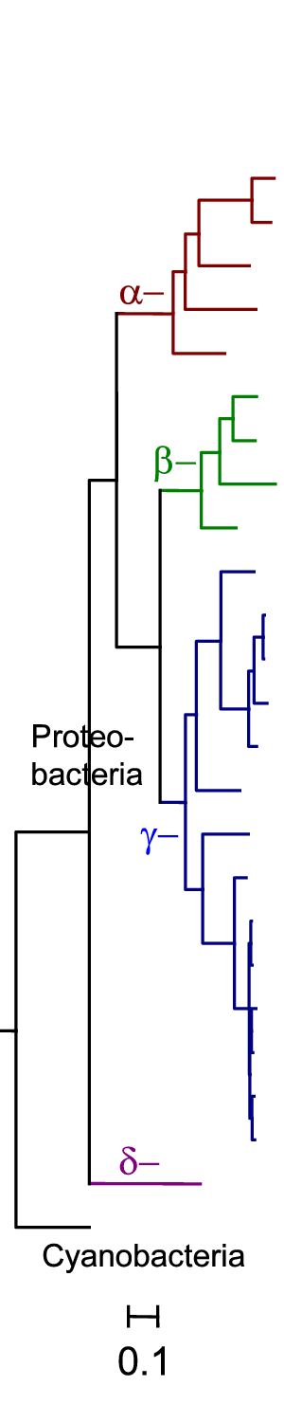
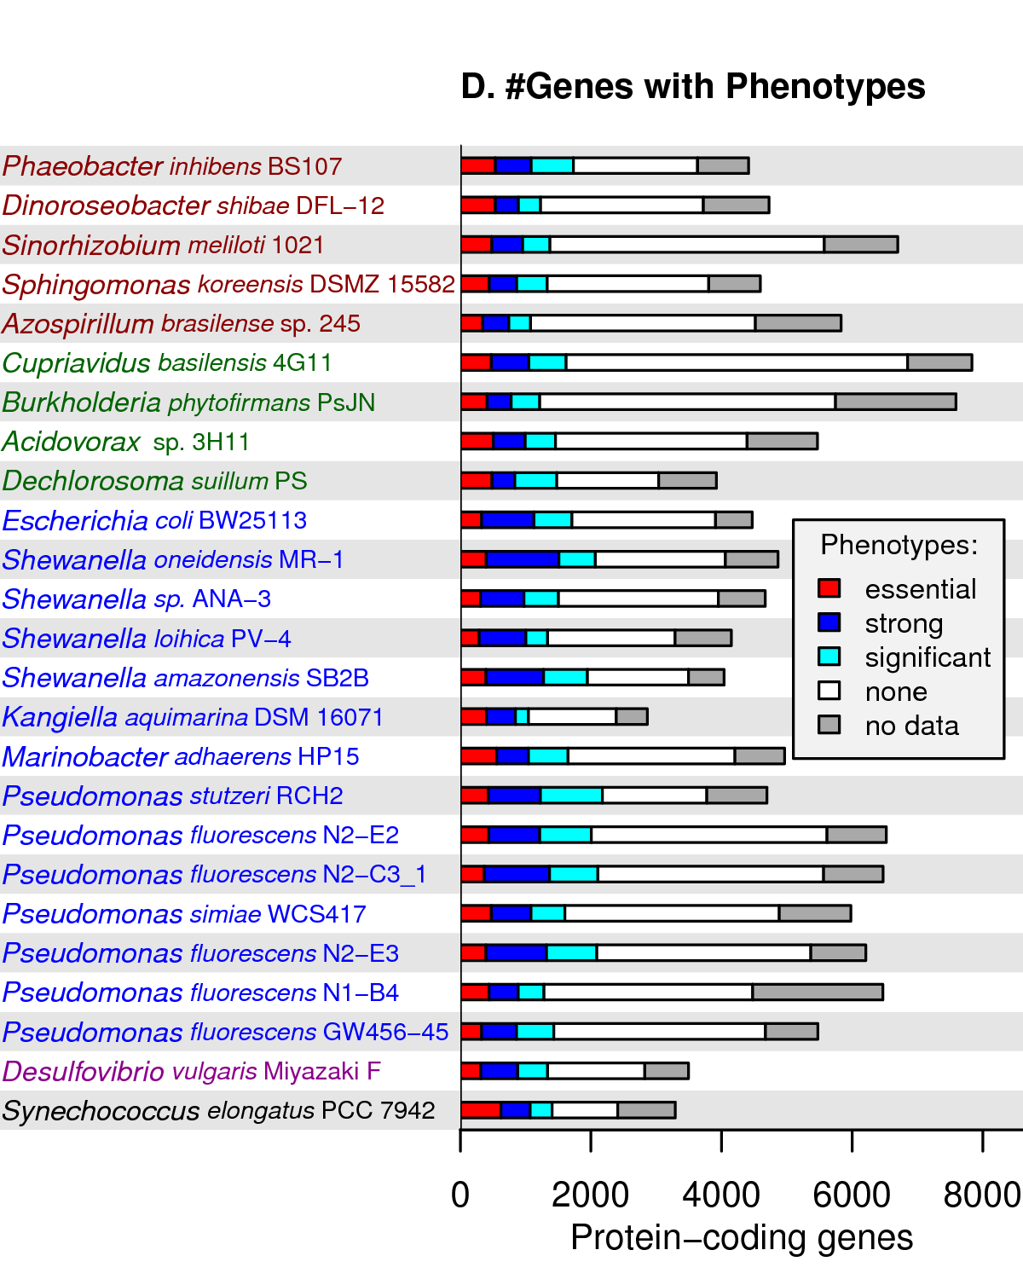
Don’t find phenotypes for many genes in monoculture
Strong:
Fitness < -2
in some condition
Significant:
FDR < 5%
in each organism
Phenotypes for:
37,900 genes
8,282 hypotheticals
From Deutschbauer and Blow (in preparation)

Slide 8
State of
Microbiome Science…

Slide 9

Wild West of Microbiome Science
NEJM
Cell
Science
Nature

Slide 10


Building on Each Other’s Results

Slide 11
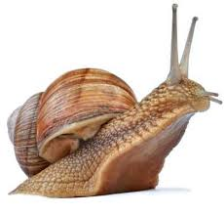
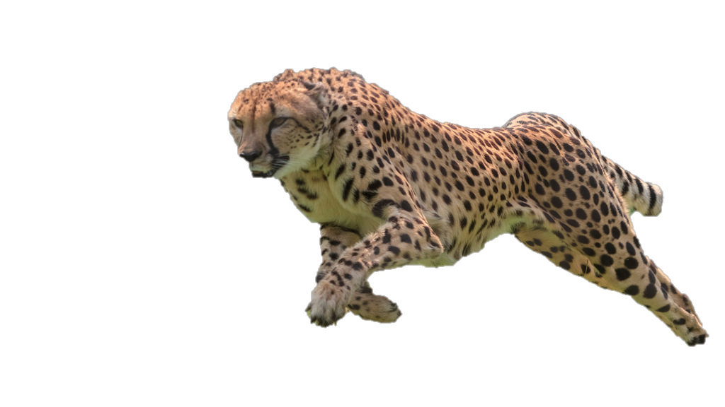
Advances in Microbiome Science
today
tomorrow

Slide 12
The Importance of
Model Systems

Slide 13
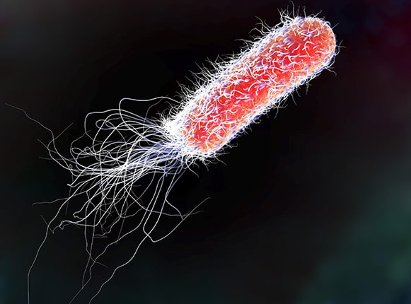
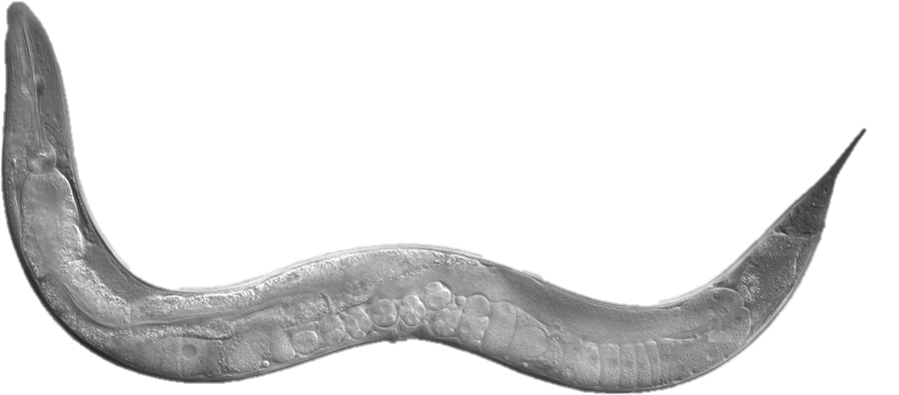
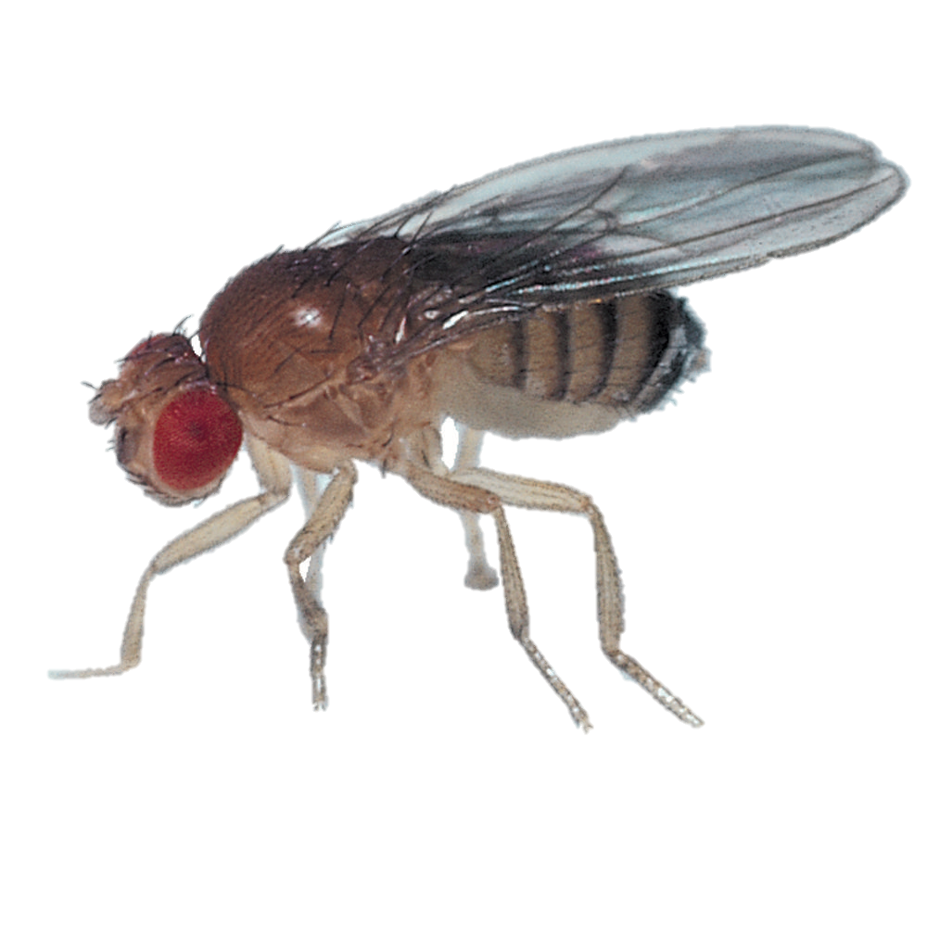
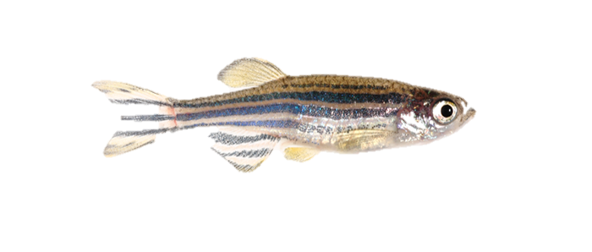
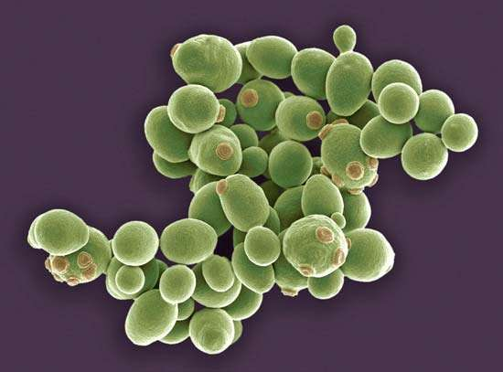
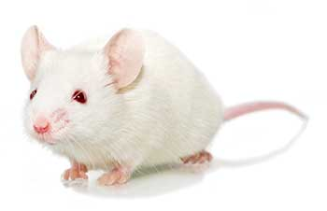
Model Systems in Biomedical Research

Slide 14
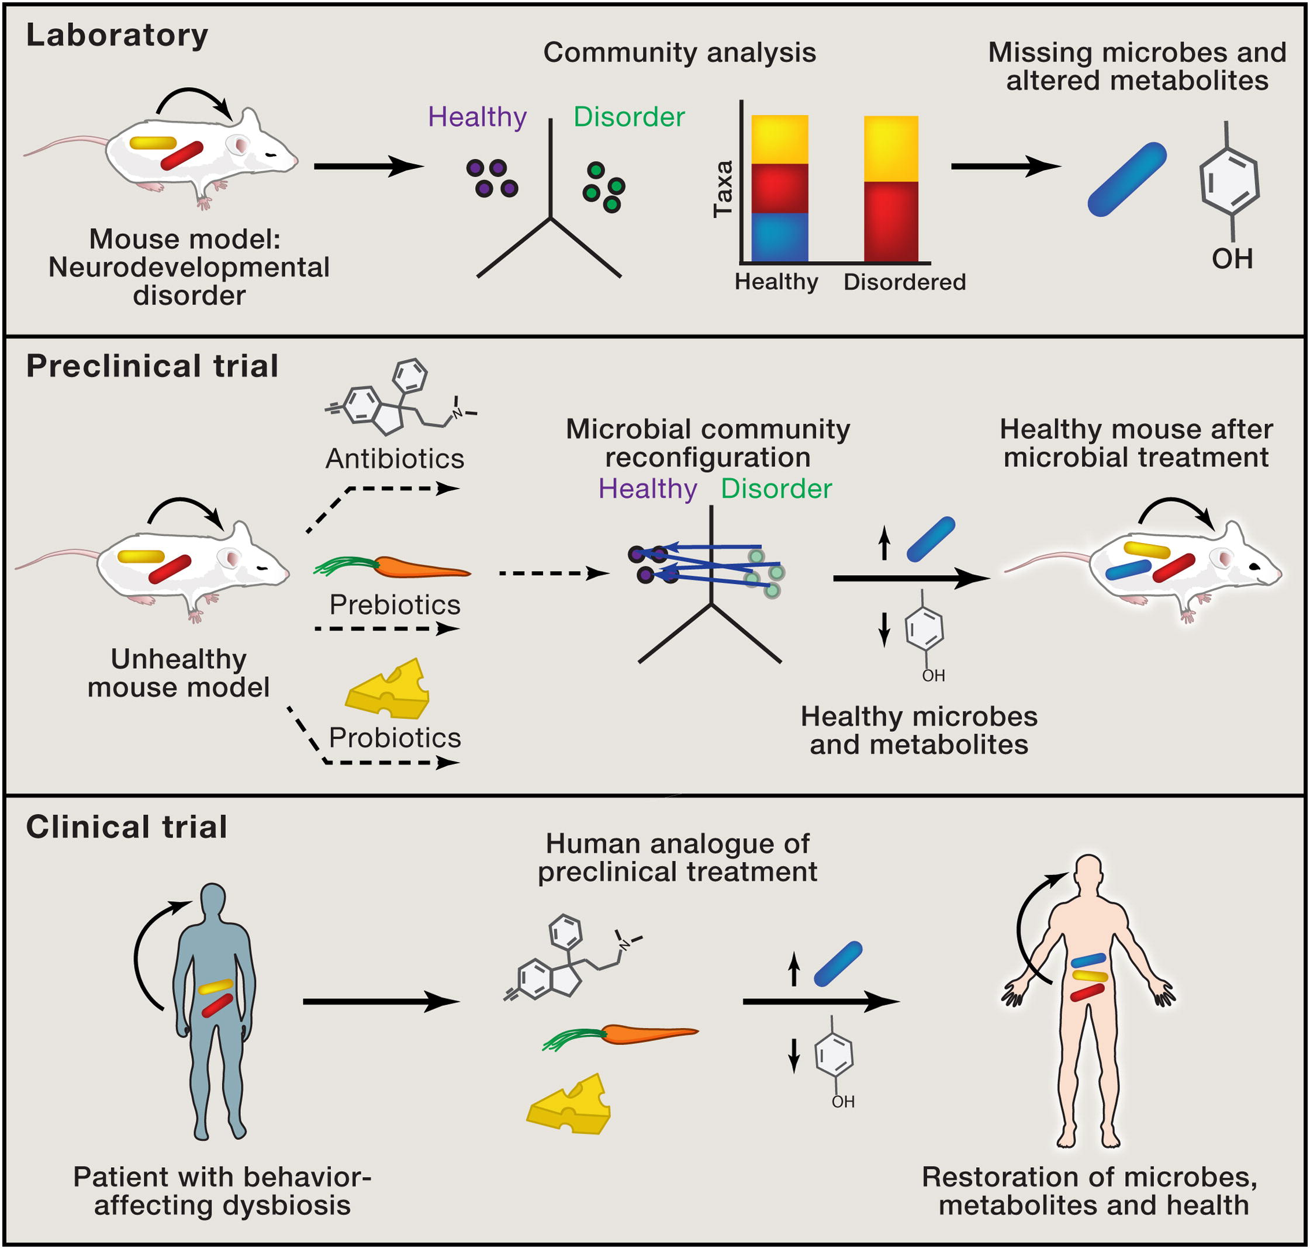
Model Systems in Biomedical Research

Slide 15
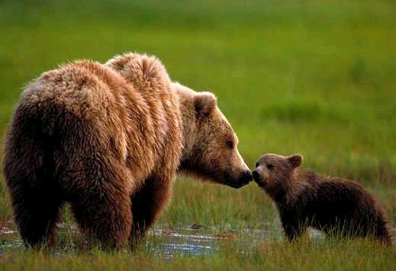
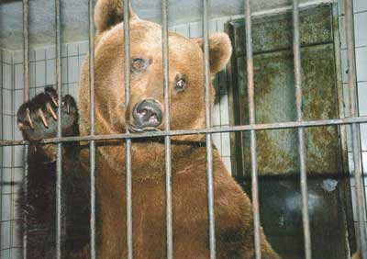
Microbes in their “real” environment

Slide 16
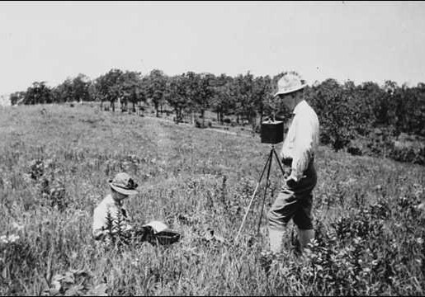
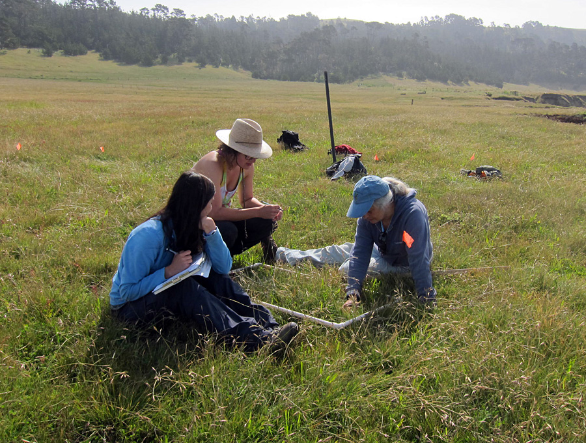
Field Studies – Now and Then…

Slide 17
Need for Controlled Ecosystem Studies

Slide 18
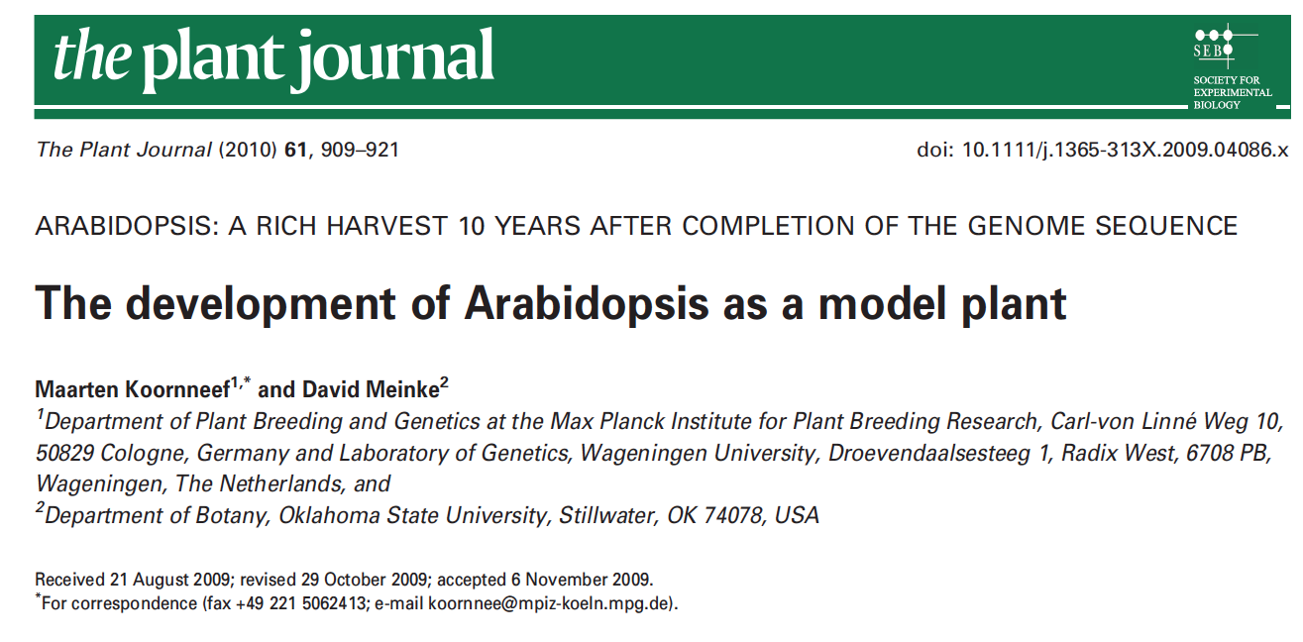
Lessons from Arabidopsis…
+40 Years

Slide 19
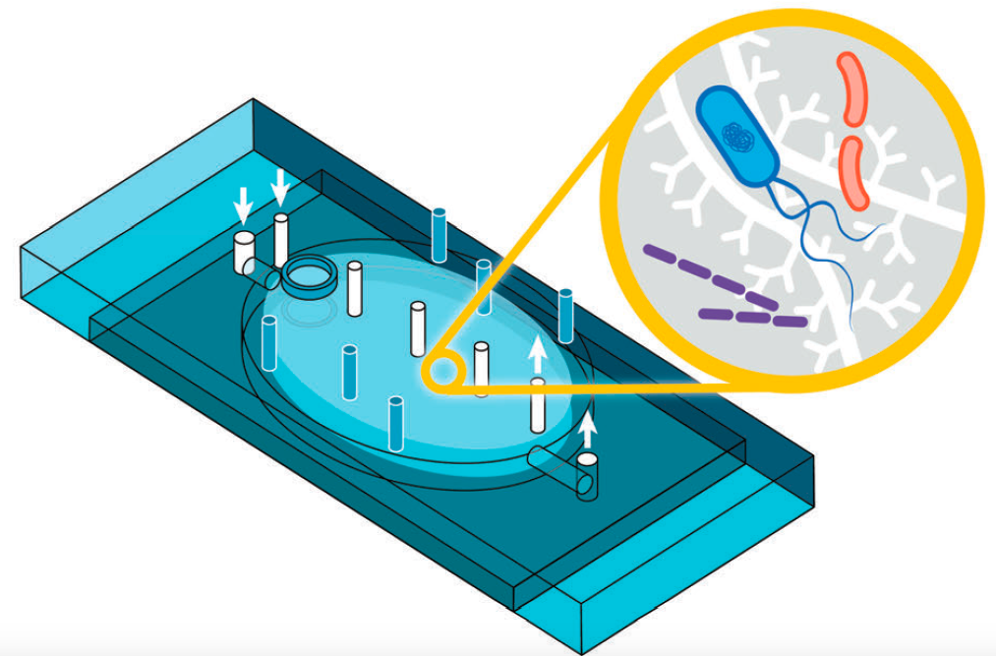
Simple (enough), Reproducible, Affordable Models

Slide 20

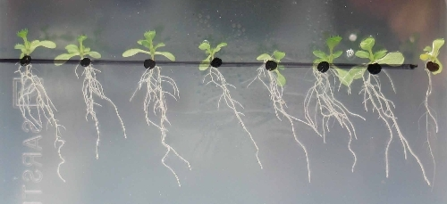
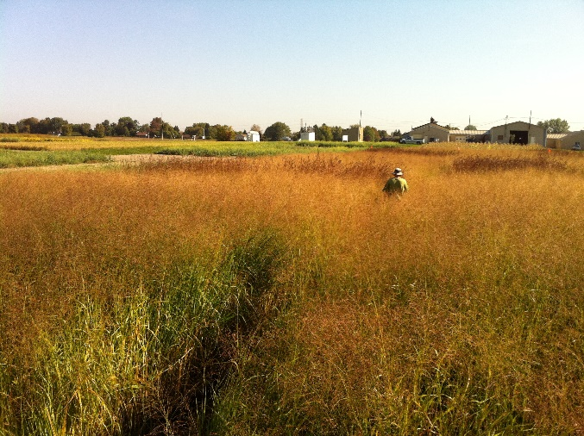

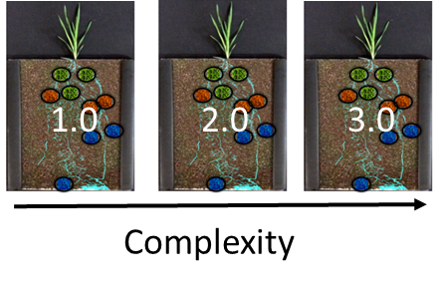
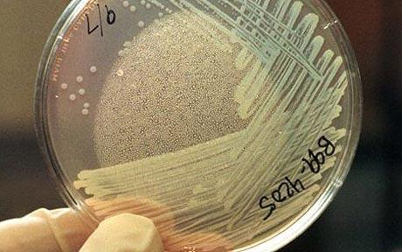
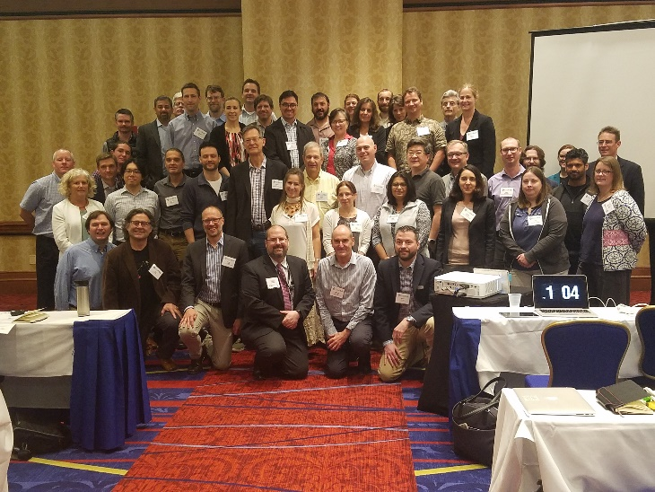
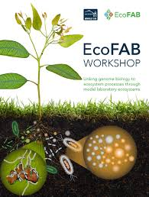
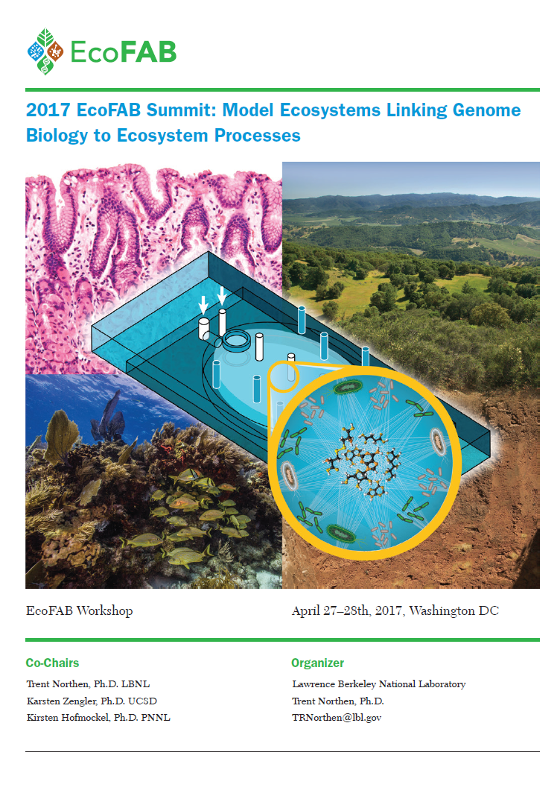
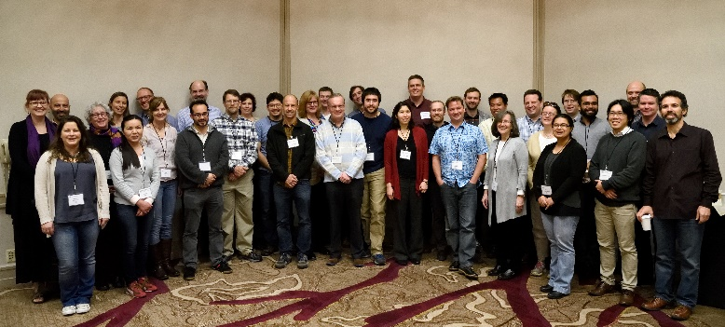

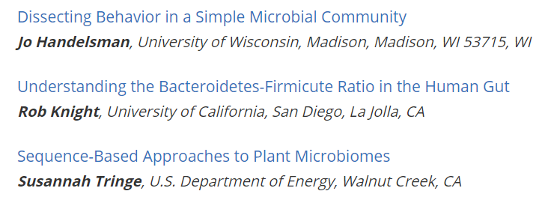
Need for Reproducible Laboratory Microbiomes
Cellular and organismal biology
Field studies
2016 EcoFAB workshop
2017 EcoFAB summit
www.eco-fab.org

Slide 21
2017 EcoFAB summit
~75 Scientists and program managers
7 Funding agencies
Diverse backgrounds
Microbiologists
Soil scientists
Plant scientists
Engineers
Data scientists
etc

Slide 22
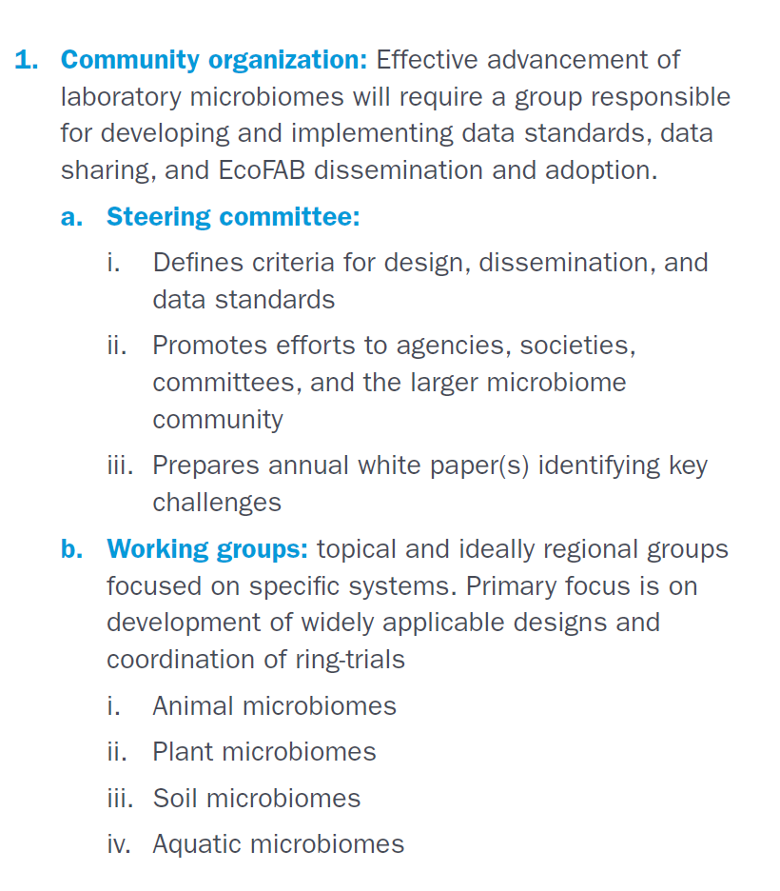
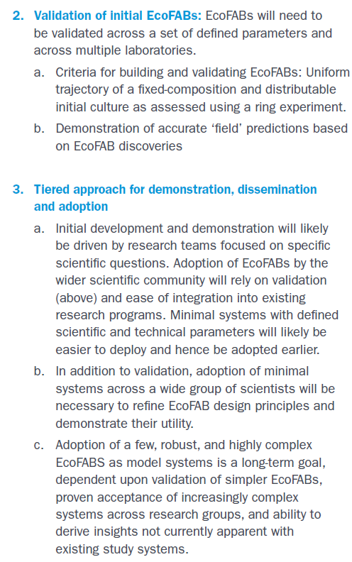
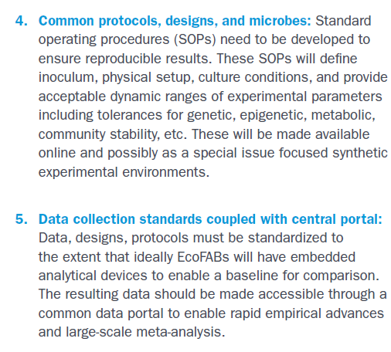
5-Point Roadmap
Community Organization
Validation of initial EcoFABs
Tiered approach for demonstration, dissemination, and adoption
Common protocols, designs, and microbes
Data collection-standards coupled with central portal

Slide 23
Recommendations 2017 EcoFAB Summit Report
Next steps
• Form steering committee and working groups
• Perform the first ring-trial for prototype EcoFAB design
• Engage the scientific community through a listening
tour and workshops
• Present EcoFAB concept to stakeholders for further
discussion
EcoFAB session at 2018 AAAS annual meeting
Genome Standards Consortium
Microbiome Interagency Working Group

Slide 24
Recommendations 2017 EcoFAB Summit Report
Next steps
• Form steering committee and working groups

Slide 25
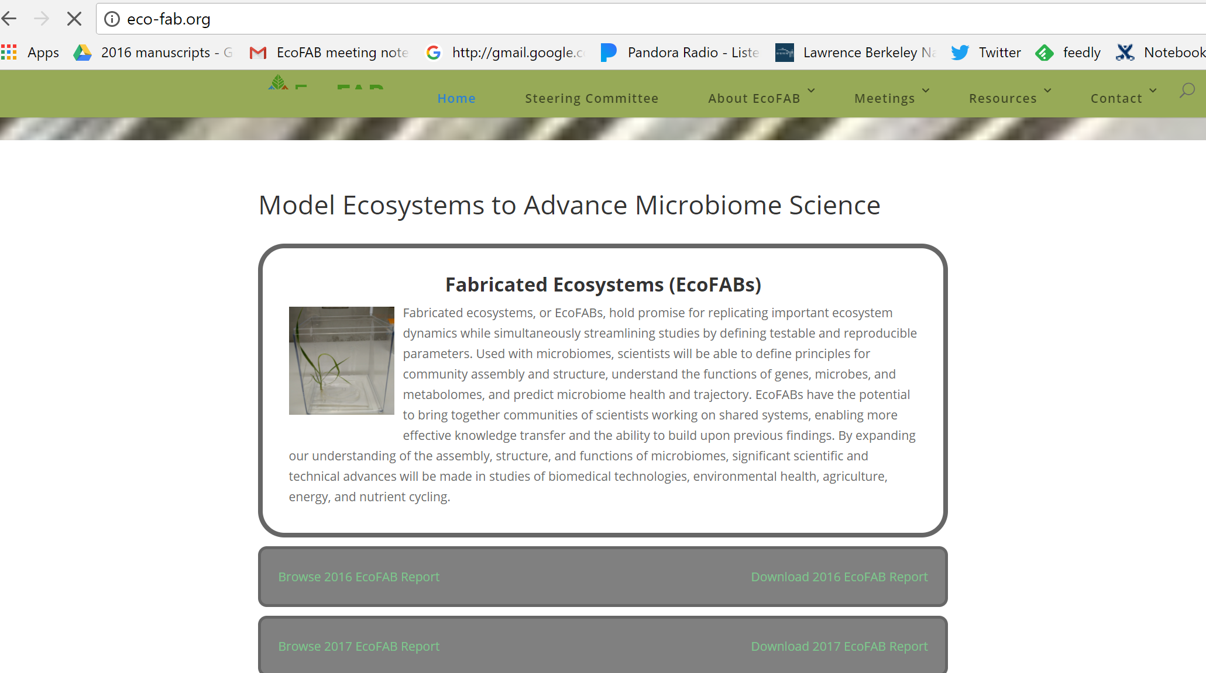
Website – eco-fab.org

Slide 26
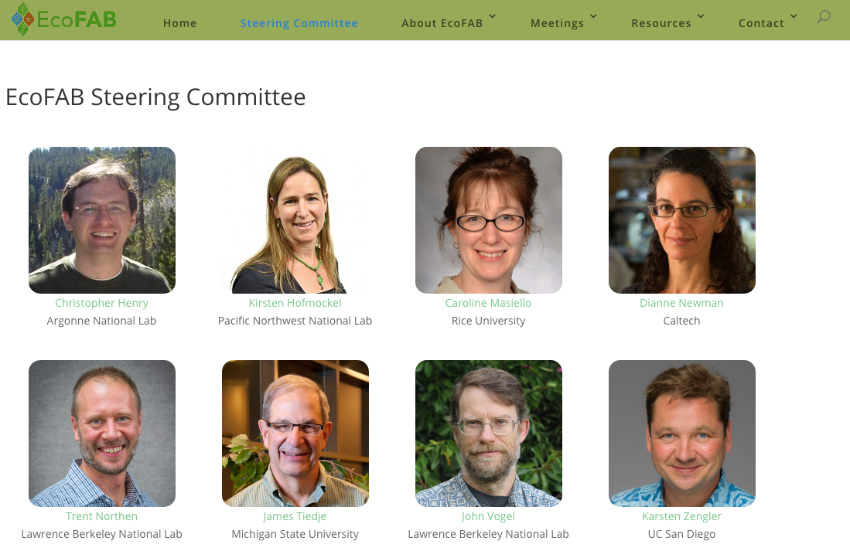
Established Steering Committee

Slide 27
Recommendations 2017 EcoFAB Summit Report
Next steps
•
• Perform the first ring-trial for prototype EcoFAB design

Slide 28
Designed EcoFAB 1.0

Slide 29



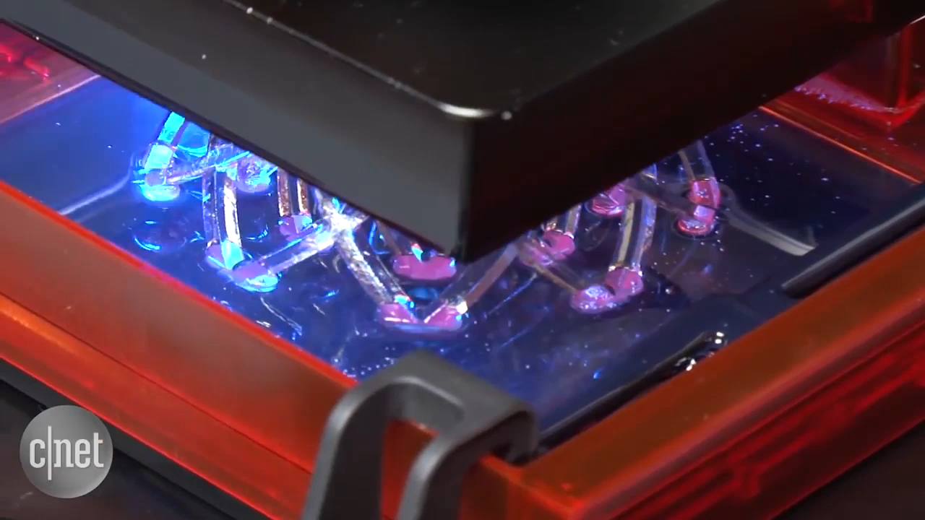
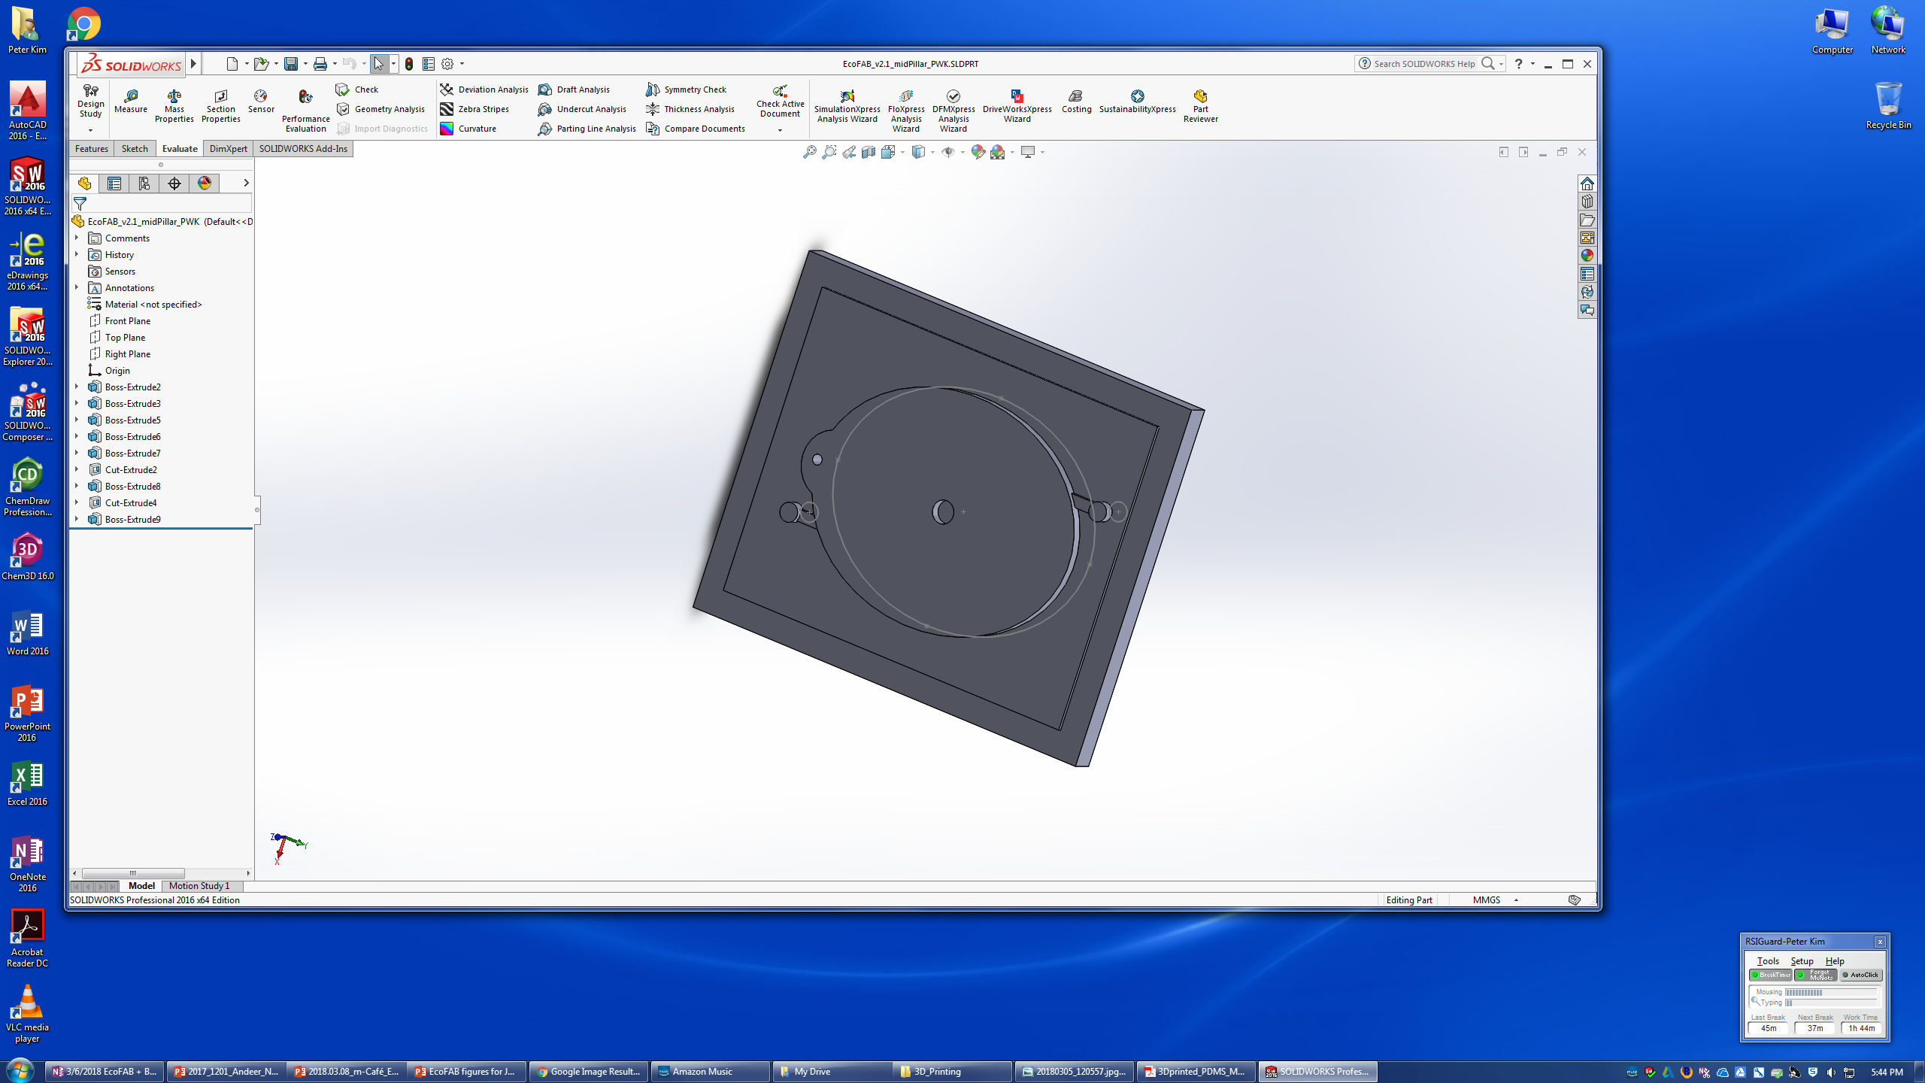
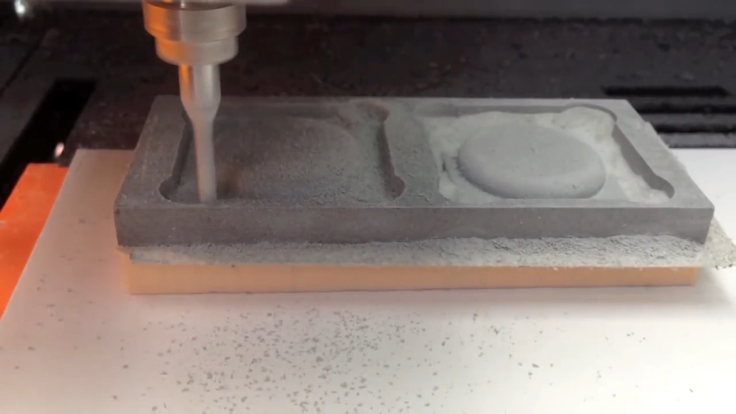
Making molds for casting EcoFABs
1. Design the mold using 3D modelling software
2. Mold construction
3D Printing
Molds with smaller features
Machine Milling
Faster mold generation

Slide 30
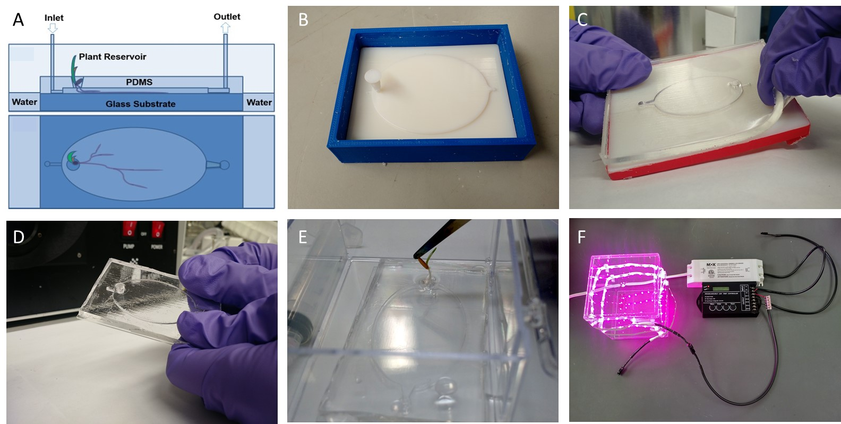
Protocol for Making EcoFAB 1.0

Slide 31
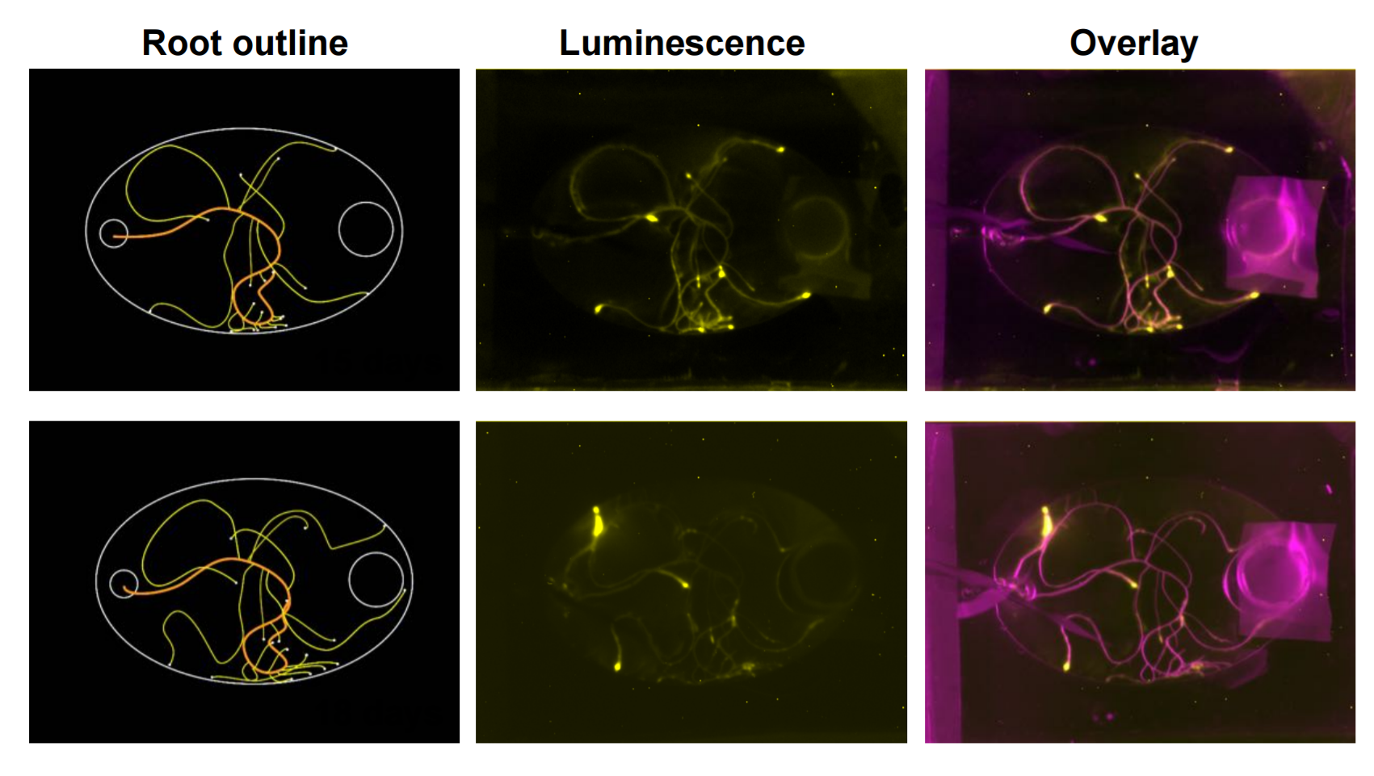
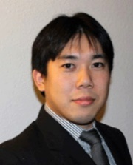
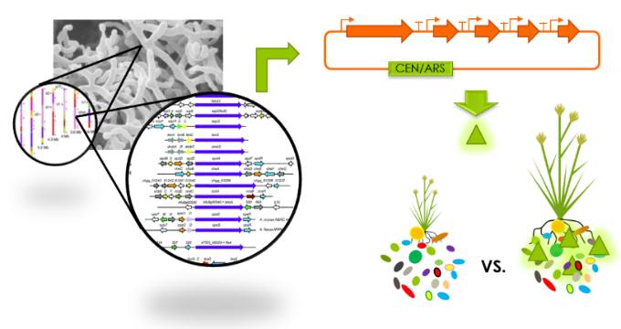
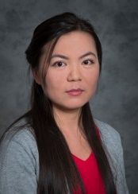
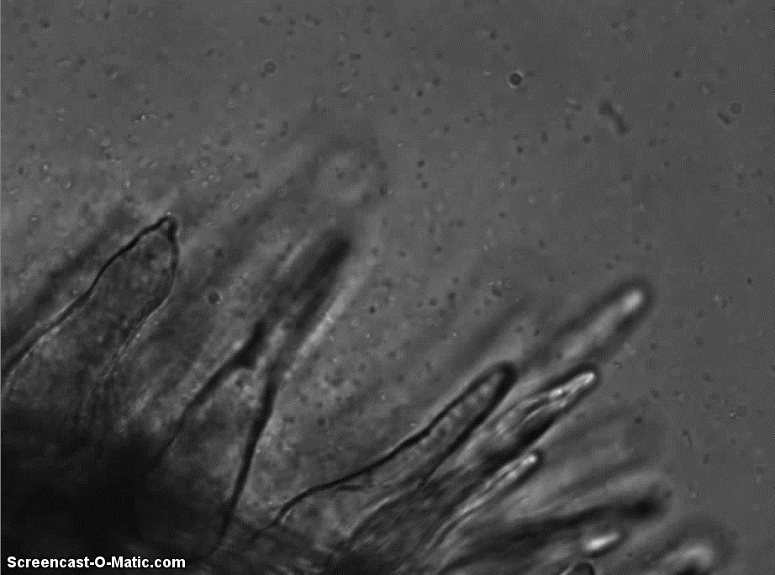
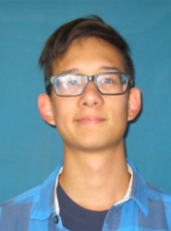
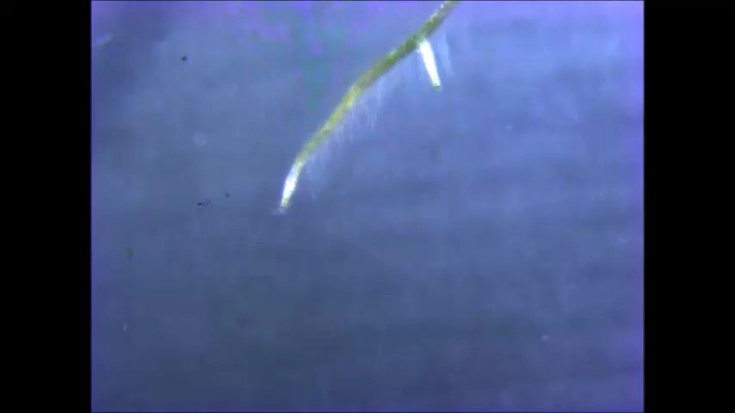
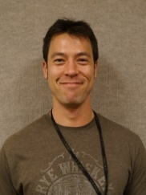
Integrating EcoFAB with synthetic biology and imaging tools
Yasuo Yoshikuni
Jian Gao
Kyle Lewald
Jason Cole
10 um

Slide 32
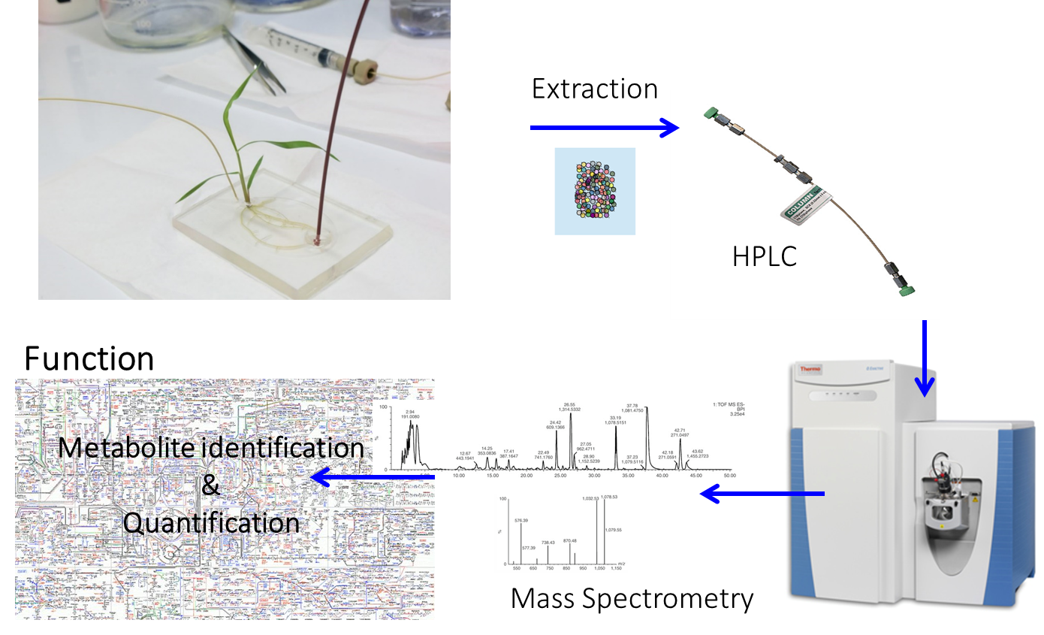
Measurement of Exometabolites

Slide 33
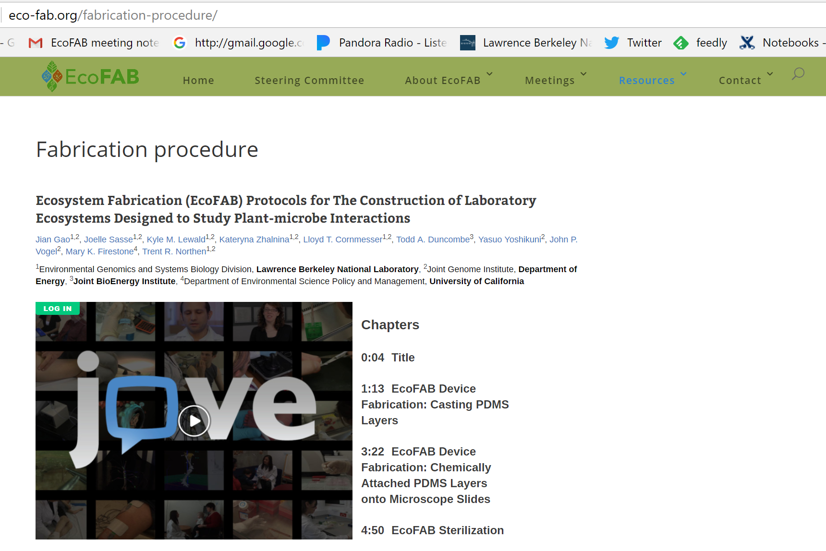
Dissemination of EcoFAB Design

Slide 34



Ring-Trial to Evaluate Reproducibility
Sorghum
Developed 3D printing approaches to make EcoFABs
Autoclavable
Successfully cultured Brachypodium, Avena, Arabidopsis, Switchgrass, Maize, and Sorghum

Slide 35



EcoFAB found to be reproducible across labs in a ring-trial experiment
Participating labs: Northen (JGI), Vogel (JGI), Dangl (UNC Chapel Hill), Watt (Forschungszentrum Jülich, Germany)
Four laboratories tested the reproducibility of the EcoFAB platform.
Brachypodium distachyon was grown in quadruplicate in EcoFABs with 0.5 MS medium (MS), MS medium without phosphate (noP) or soil extract (soil).
Root morphology was imaged and exudates were collected.
Tissue weight and phosphate content were analyzed and metabolomics was performed.
Root Exudates cluster by treatment not laboratory
Notes:
The model grass Brachypodium distachyon was grown in quadruplicates in sterile EcoFABs supplied with 0.5 MS medium (0.5 MS), 0.5 MS medium without phosphate (noP), and in soil extract (soil). Root morphology was imaged weekly, and exudates were collected in the third and final week. Tissue weight and tissue phosphate content were analyzed by all laboratories, and metabolomics was performed on the tissues and exudates by the host laboratory.

Slide 36
Recommendations 2017 EcoFAB Summit Report
Next steps
•
•
• Engage the scientific community through a listening
tour and workshops
• Present EcoFAB concept to stakeholders for further
discussion
EcoFAB session at 2018 AAAS annual meeting
Genome Standards Consortium
Microbiome Interagency Working Group

Slide 37


AAAS Scientific Session

Slide 38
Recommendations 2017 EcoFAB Summit Report
Next steps
• Form steering committee and working groups
• Perform the first ring-trial for prototype EcoFAB design
• Engage the scientific community through a listening
tour and workshops
• Present EcoFAB concept to stakeholders for further
discussion
EcoFAB session at 2018 AAAS annual meeting
Genome Standards Consortium
Microbiome Interagency Working Group

Slide 39
Recommendations 2017 EcoFAB Summit Report
Next steps
• Form steering committee and working groups
• Perform the first ring-trial for prototype EcoFAB design
• Engage the scientific community through a listening
tour and workshops
• Present EcoFAB concept to stakeholders for further
discussion
EcoFAB session at 2018 AAAS annual meeting
Genome Standards Consortium
Microbiome Interagency Working Group

Slide 40
Input from GSC
What process to use when establishing protocols/standards?
Opportunities to work with GSC to develop such standards?
How to publicize, disseminate, and “enforce” standards?
Lessons learned from the dawn of the genomics age?

Slide 41

Long-term vision for EcoFAB integration with field studies and modeling efforts

Slide 42
Acknowledgement
Community Effort
Trent Northen (LBNL)
Chris Henry (ANL)
Kirsten Hofmockel (PNNL)
Carline Masiello (Rice)
Dianne Newman (CalTech)
James Tiedje (MSU)
John Vogel (LBNL)

Slide 43

Questions

